Slide 1
Elective Recommendation System
PIP104 University Project-II
Roll Number | Student Name
20211COM0076 | Abhinit
20211COM0015 | Vinay Kumar G R
20211COM0044 | Mohammed Ovez Basha
20211COM0049 | Varsha Kantharaja Bothanahalli
20211COM0051 | Manjunath K Konu
Under the Supervision of,
Dr. Sandeep Albert Mathias
Assistant Professor
School of Computer Science &
Engineering Presidency University

Slide 2
Introduction
As the number of elective courses available in institutions of higher learning climbs to the sky, decision making for students on which to focus on has become more and more difficult. This problem is made worse by differences in academic qualifications, interests, and career goals of students. Conventionally, the elective selection process is done manually and therefore does not take into consideration an individual’s preferences, which results in dissatisfaction, separation of academic objectives, and inefficient utilization of students’ capabilities. These inefficiencies can also lead to an unequal allocation of students to courses leading to logistical problems for university departments.
With the help of new AI based strategies, the Elective Recommendation System proposes to mitigate such problems. The system recommends students' best courses suited to their personalities thus bridging the gap between the students and their courses. The system combines both content-based and collaborative filtering approaches to ensure that students use an online system to assist them in choosing courses, thereby making the entire process less personal and descriptive.
The problem of efficient distribution of elective courses for students and academic colleges is resolved by this model Its scope covers:
Individual Feedback: The system employs a content-based approach and a collaborative filtering-based approach to recommend the courses that best fit the student's academic results together with his/her area of specialization.
Graphical User Interface: The use of React, HTML, CSS, and Java Script enhances the user interface thus eliminating the experience while reducing the learning duration for both students and administrators.

Slide 3
Literature Review
Sl. No | Title of the Paper | Authors | Technology/ Concept Used | Results/ Findings | Limitations/ Challenges
1 | A Systematic Review of Recommendation Systems for Course Selection | Sharoq Algarni, Fredrick Sheldon (2023) | Collaborative filtering, content-based filtering, hybrid methods | Identified gaps in elective recommendation systems focusing on datasets used and preprocessing methods | Lack of public datasets and clear preprocessing methods in most studies
2 | A Review of Recommender Systems for Choosing Elective Courses | Mfowabo Maphosa et al. (2020) | Content-based and hybrid recommendation systems | Systematic literature review revealing a focus on academic choice, particularly elective courses | Ambiguity in emerging data mining trends and limitations in scalability
3 | Collaborative Filtering Approaches for Elective Course Recommendations | Cai et al. (2022) | Memory-based and model-based collaborative filtering | Found collaborative filtering methods effectively predict student course preferences | Overreliance on historical data limits adaptability
4 | Personalized Course Recommendation Using User-Based Collaborative Filtering | Kim et al. (2019) | User-based collaborative filtering | Personalization improved the relevance of course recommendations for students | Cold-start problem for new students with insufficient data

Slide 4
Sl. No | Title of the Paper | Authors | Technology/ Concept Used | Results/ Findings | Limitations/ Challenges
5 | A Comparative Study on Recommender Systems for Academic Courses | Sharma and Mehta (2021) | Collaborative filtering, matrix factorization | Comparison of algorithms showed matrix factorization models performed better for large datasets | Computational complexity of matrix factorization
6 | A Machine Learning Approach for Elective Course Recommendation | Rahman et al. (2020) | Machine learning, collaborative filtering | Combined machine learning techniques with collaborative filtering to improve recommendation accuracy | High dependency on feature selection and training data quality
7 | Course Recommender Systems in Higher Education: Trends and Applications | Wong et al. (2020) | Hybrid recommendation systems | Found hybrid models combining collaborative and content-based filtering achieved better accuracy | Hybrid systems require more computational resources
8 | Enhancing Academic Course Recommendation Using Social Network Analysis | Li and Liu (2021) | Social network analysis, collaborative filtering | Incorporated social interaction data to enhance course recommendation accuracy | Difficulty in collecting and integrating social network data with academic data
9 | Elective Course Recommendation Based on Student Performance and Preferences | Singh and Patel (2022) | Content-based filtering, collaborative filtering | Enhanced recommendations by considering both student performance and preferences | Scalability issues with large datasets and diverse course offerings
10 | Recommending Elective Courses Using Deep Learning Techniques | Chen et al. (2021) | Deep learning, collaborative filtering | Deep learning techniques improved recommendations for complex student profiles | Requires large amounts of training data and high computational power

Slide 5
Objectives
Personalized Course Recommendations
Incorporation of Advanced Algorithms
Scalability and Flexibility
User-Friendly Interface
Data-Driven Decision Making

Slide 6
Methodology
In this project, collaborative filtering is applied to recommend electives to students based on their preferences and academic history. The methodology is broken down into several stages: data collection, preprocessing, model development, and evaluation. Below is a detailed description of the methodology used:
1. Data Collection:
The first step is to collect the necessary data required for the recommendation system. This includes:
Student Profile Data:
Student IDs, academic year, department, and other basic demographic information.
Past elective choices, including which electives were taken by each student and their performance (if available).
Elective Data:
Information on available electives, such as course titles, course codes, prerequisites, and elective capacities.
Historical popularity of each elective, measured by the number of students enrolled in previous semesters.
Student Preferences:
Historical data on student preferences (ranked list of electives) or direct feedback on electives if available.
The data can be collected from existing university databases, academic records, or student surveys.

Slide 7
Methodology
2. Data Preprocessing:
Clean the data (handling missing values, normalization).
Transform the data into a student-elective matrix for collaborative filtering.
3. Collaborative Filtering Model:
Implement user-based collaborative filtering to find similar students based on elective preferences.
Implement item-based collaborative filtering to recommend electives based on similar electives the student has already taken.
Use similarity measures like cosine similarity or Pearson correlation to compute similarities between users or items.
4. Recommendation Generation:
Predict electives for students based on similar students (user-based) or electives (item-based).
Factor in constraints like elective capacity and prerequisites.
5. System Deployment:
Build the backend and integrate the recommendation model into the web application.
Deploy the system using cloud services (Heroku or AWS) and make it available for testing.
6. Evaluation:
Conduct user testing to assess student satisfaction with the recommendations.

Slide 8
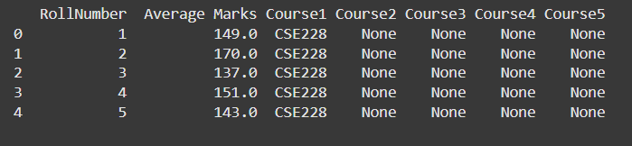
Methodology
Content Based Approach :
Input: The aggregate marks of the student are given as input data.
Methodology
Calculate the average scoring potential for each course in the dataset.
Compare the marks given by the student against these scoring potentials(user input).
Identify courses where the scoring potential closely matches the input marks of the student, with threshold.
Present a ranked list of recommended courses.
Example: In the case of a course with an average scoring capability of 152, if a student submits a cumulative score of 150, the course would be appropriate for recommendation.

Slide 9
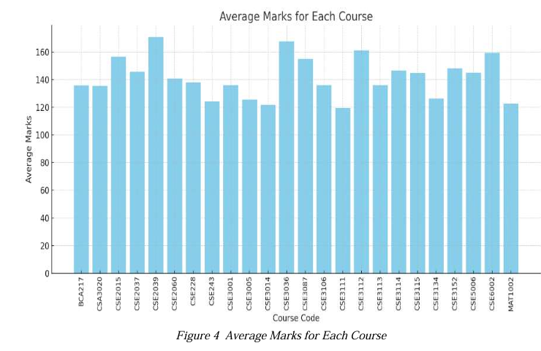
Methodology
Content based Approach :

Slide 10
Methodology
Collaborative Approach :
Collect Data:
The system uses a ratings matrix where rows are students, columns are courses, and the values are marks (or ratings).
Find Similar Students:
It calculates the similarity between students based on their course marks using cosine similarity. This determines how alike two students are in their preferences.
Aggregate Preferences:
For a target student, the system identifies the most similar students.
It uses the marks of these similar students to estimate how much the target stuent will like the course that they haven’t taken.
Generate Recommendations:
The system predicts scores for the courses the student hasn’t taken.
It ranks these courses based on the predicted scores and recommends the top ones.

Slide 11

Methodology
Collaborative Approach
Simple Analogy: "If students similar to you liked these courses, you’ll probably like them too!"

Slide 12
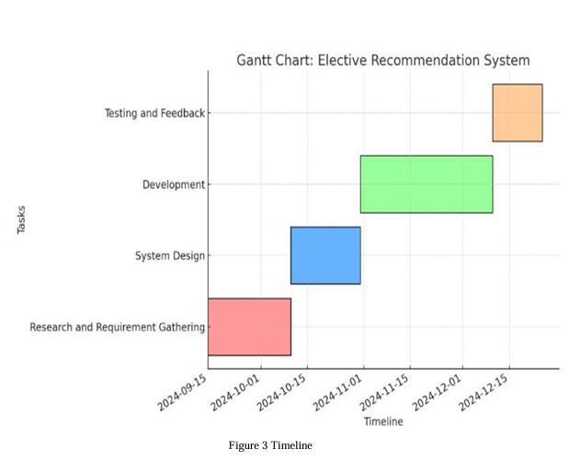
Timeline of Project

Slide 13
Expected Outcomes
The Elective Recommendation System developed using collaborative filtering aims to deliver the following key outcomes:
Improved Elective Allocation
The system provides personalized elective recommendations to students based on their past preferences and academic history. This
reduces the likelihood of students being arbitrarily assigned electives, thus ensuring higher student satisfaction with their elective
choices.
Enhanced Student Experience and Satisfaction
By offering students recommendations tailored to their academic interests and past choices, the system enhances the overall student
experience, reducing confusion and frustration related to elective selection. Students are more likely to receive electives aligned with their
preferences, improving satisfaction levels.
Reduction in Arbitrary Assignment
By minimizing the need for manual assignment of electives to students, the system decreases instances where students receive electives
they have no interest in. This fosters a more engaging academic environment where students are enrolled in courses that match their
interests and career goals.
Data-Driven Decision Making for HoDs
HoDs can view real-time data on elective demand and student distribution, enabling them to make informed decisions about elective
assignments and better manage class sizes, minimizing conflicts between student demand and available seats.

Slide 14
Conclusion
The Elective Recommendation System developed using collaborative filtering addresses a significant challenge faced by students and administrators at Presidency University: the arbitrary assignment of electives and the misalignment of student preferences with available courses. Through personalized recommendations, the system enhances the decision-making process for both students and HoDs, ensuring a fairer and more efficient elective allocation process.
The project demonstrates how data-driven approaches can be applied to solve complex allocation problems in academic environments, making the elective selection process more transparent and reducing manual intervention. The system is scalable, allowing it to improve over time as more data is collected, and can be adapted to future academic cycles, offering long-term benefits to both students and academic administrators.
In conclusion, this recommendation system provides a practical, scalable solution to elective assignment issues, improving the overall academic experience for students while optimizing administrative efficiency at Presidency University.
Future Works
➢ Expanding the dataset to include additional parameters such as course prerequisites, student feedback, and career aspirations.
➢ Incorporating machine learning models like matrix factorization or deep learning for more nuanced recommendations.
The results demonstrate that this recommendation system is a promising tool for educational institutions, providing both scalability and customization. Future iterations can further refine its capabilities to achieve an even broader impact Project Timeline.

Slide 15
References
"Helping university students to choose elective courses by using a hybrid multi-criteria recommendation system“
Published in Knowledge-Based Systems (2020) DOI: 10.1016/j.knosys.2019.105385
"A Collaborative Filtering Based Approach for Recommending Elective Courses" This study explores how collaborative filtering can be used to predict grades and assist in elective selection, helping students choose based on performance potential.
Published by Springer (2020) DOI: 10.1007/s00500-020-05178-6
"A Matrix Factorization-based Collaborative Filtering Framework for University Course Recommendation" This framework applies matrix factorization to recommend courses based on academic history and preferences, focusing on adaptability and personalization.
Published by IEEE Xplore (2020) DOI: 10.1109/ACCESS.2020.3012287
Amsaad, Fathi, et al. (2023). "E-Learning Course Recommender System Using Collaborative Filtering Models." Electronics. This paper explores the implementation of collaborative filtering models such as K-Nearest Neighbors (KNN), Singular Value Decomposition (SVD), and neural network–based models for recommending e-learning courses based on student preferences. [MDPI, DOI: 10.3390/electronics12010157]​
Lee, Eric L., et al. (2017). "A Collaborative Filtering-Based Two Stage Model with Item Dependency for Course Recommendation." IEEE International Conference on Data Science and Advanced Analytics (DSAA). [DOI: 10.1109/DSAA.2017.18]​

Slide 16
Github Link
https://github.com/Abhinit006/Elective-Recommendation-System
The provided link is a public GitHub repository where the complete project has been uploaded. It contains all the necessary files, code, and documentation required for the project. This repository serves as a centralized location for accessing, reviewing, and managing the project resources.

Slide 17
Thank You

